Slide 1
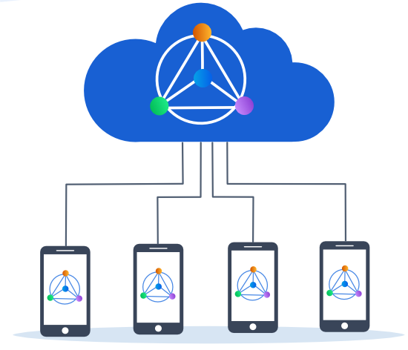
Collaborative Machine Learning

Slide 2
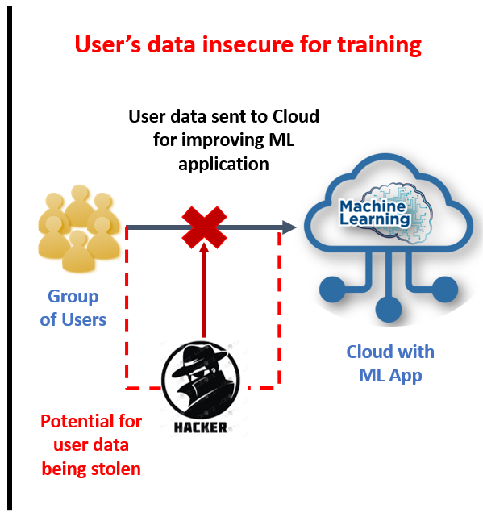
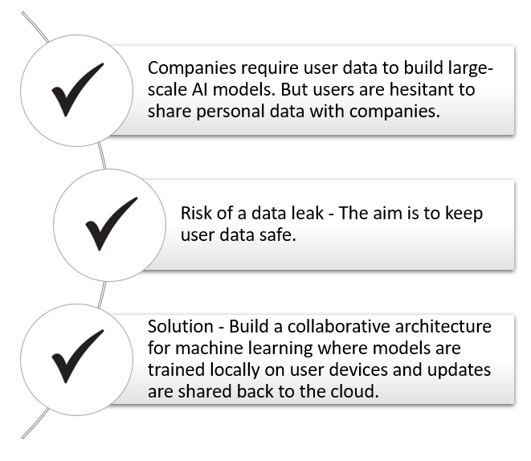
Problem Statement

Slide 3
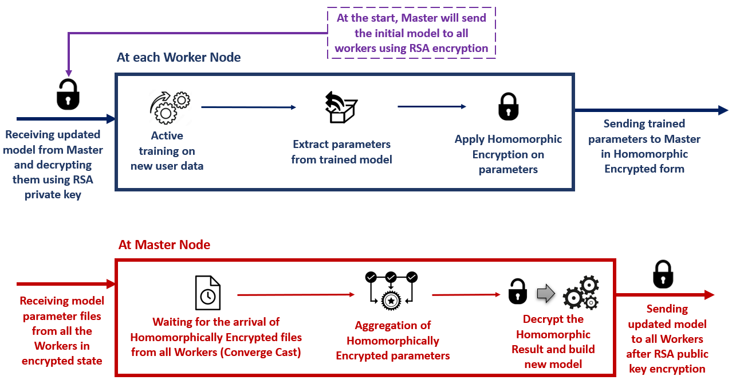
System Design: Encryption Mechanism and Workflow

Slide 4
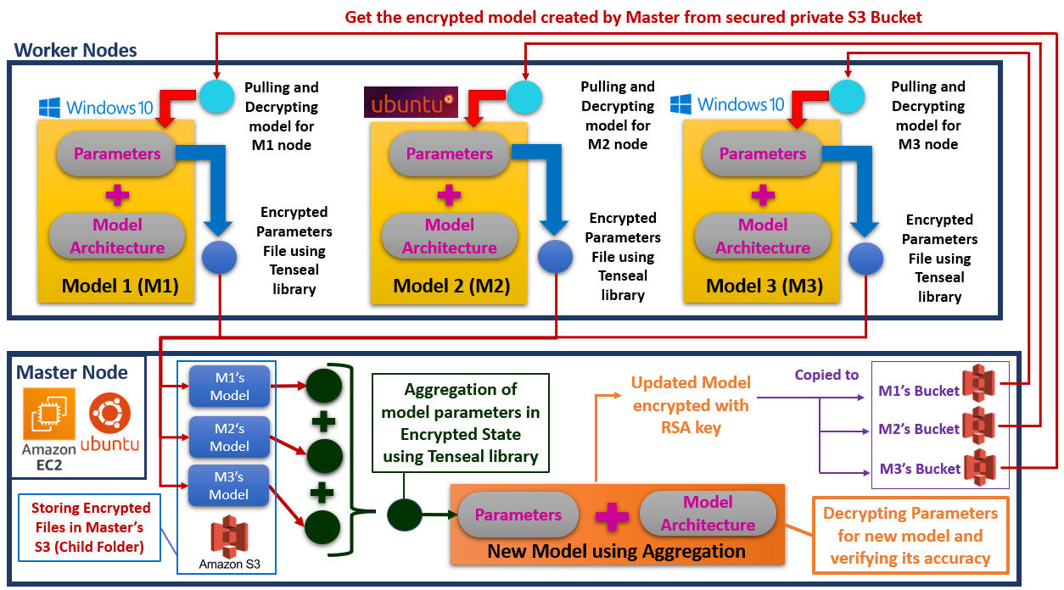
System Design: Architecture

Slide 5
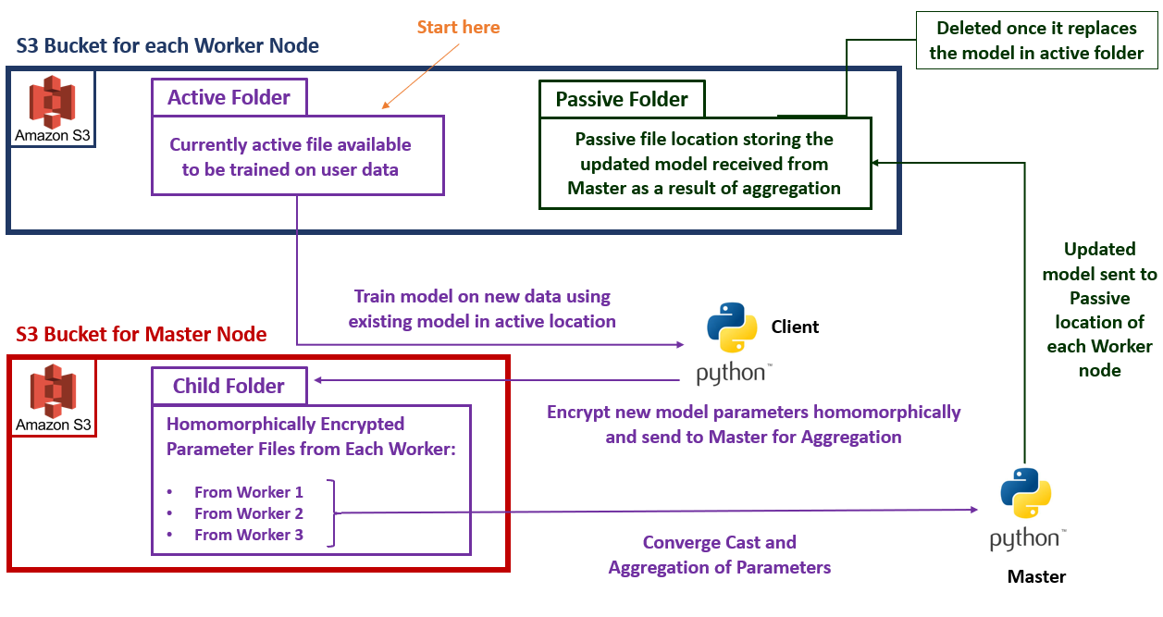
Implementation: ML Model Storage and Management

Slide 6
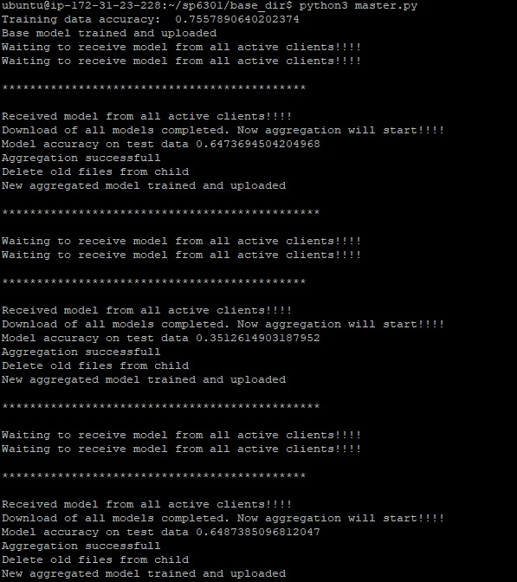
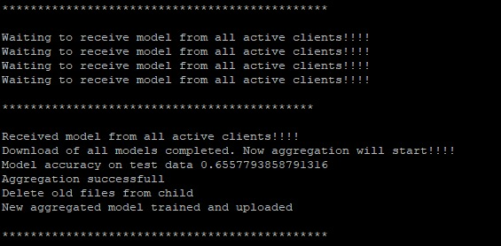
Screenshots: Master-side

Slide 7
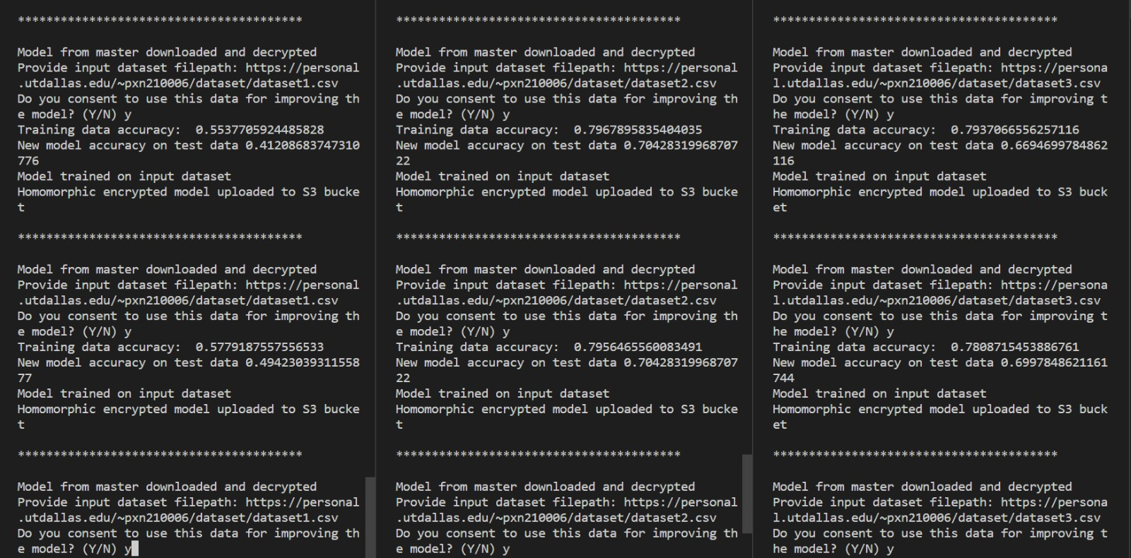
Screenshots: Client-side

Slide 8
Challenges Encountered
Secure sharing of trained models between the user and the cloud
Use asymmetric encryption on model architecture when sending model from master to worker.
Communication between clients and cloud
Perform distributed communication between the clients and the cloud.
Keeping data intact when updated model is shared back to the master using homomorphic encryption.
Used secure socket communications using a distributed architecture.
Implementing shared cloud storage architecture like S3 to perform secure communication.

Slide 9
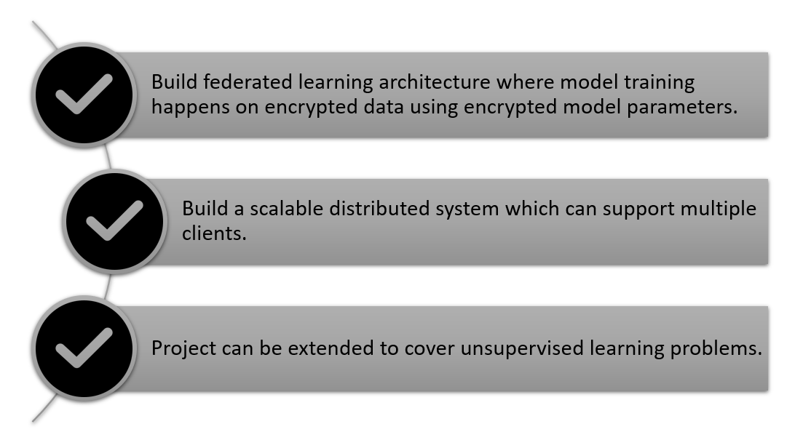
Directions or Scope

Slide 10
Thank You

